Slide 1

Application Layer
Principles of network applications
Web and HTTP
E-mail, SMTP, IMAP
The Domain Name System: DNS
P2P applications
video streaming, CDNs
socket programming
supplemental: 3rd party cookies, web tracking
Computer Networking: A Top-Down Approach 8th edition Jim Kurose, Keith Ross Pearson, 2020
Notes:
Version History
January 2022

Slide 2

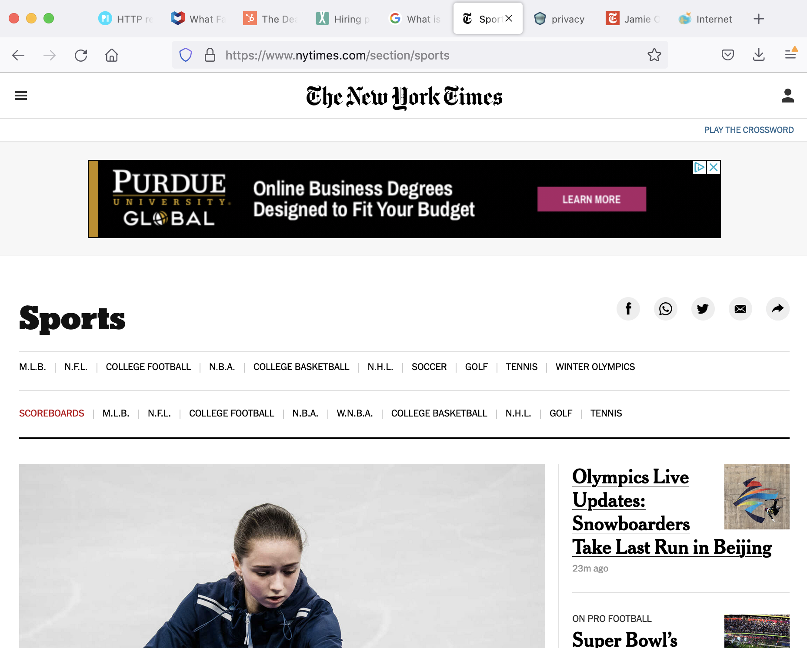

Review: one web page - “pieces” from many servers

Slide 3
Review: one web page - “pieces” from many servers
content from 3rd party ad server, e.g., AdX.com
content from nytimes.com

Slide 4

Review: one web page - “pieces” from many servers
Web browser:
contacts nytimes.com to get base page
finds reference to ad embedded in base page
contacts AdX.com to get ad
assembles, displays page
“make HTTP request to AdX.com to get ad that goes here”

Slide 5


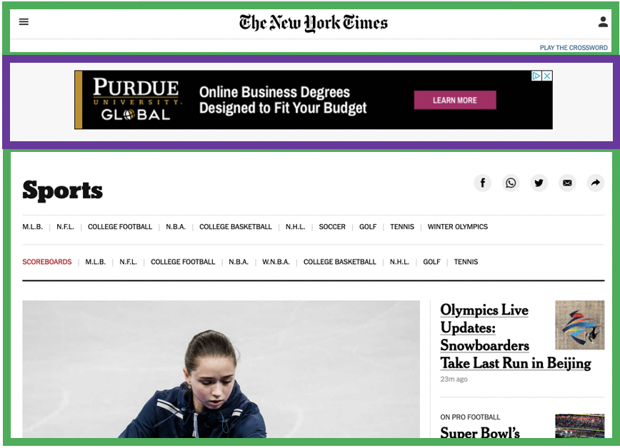

Example: displaying a NY Times web page
1
GET base html file from nytimes.com
2
fetch ad from AdX.com
nytimes.com
4
5
HTTP GET
1
2
HTTP reply
7
display composed page
3
4
6
5
NY times page with embedded ad displayed
AdX.com

Slide 6
Cookies: tracking a user’s browsing behavior
1634: sports, 2/15/22
nytimes.com (sports)
“first party” cookie – from website you chose to visit (provides base html file)
HTTP
GET
HTTP reply
Set cookie: 1634
HTTP GET
Referer: NY Times Sports
4
5
7493: NY Times sports, 2/15/22
“third party” cookie – from website you did not choose to visit
HTTP reply
NY Times: 1634
Set cookie: 7493
AdX.com
AdX: 7493

Slide 7
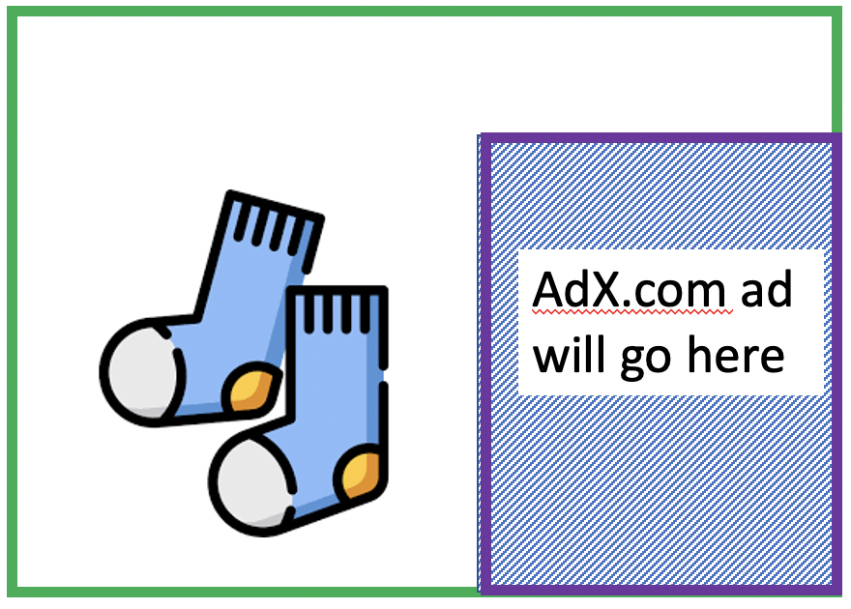
Cookies: tracking a user’s browsing behavior
1634: sports, 2/15/22
nytimes.com
AdX:
tracks my web browsing over sites with AdX ads
can return targeted ads based on browsing history
socks.com
HTTP reply
2
HTTP GET
1
HTTP GET
Referer: socks.com, cookie: 7493
4
7493: NY Times sports, 2/15/22
5
7493: socks.com, 2/16/22
HTTP reply
NY Times: 1634
Set cookie: 7493
AdX.com
AdX: 7493

Slide 8

Cookies: tracking a user’s browsing behavior (one day later)
1634: sports, 2/15/22
1634: arts, 2/17/22
nytimes.com (arts)
socks.com
HTTP
GET
HTTP reply
cookie: 1634
Set cookie: 1634
HTTP GET
Referer:nytimes.com, cookie: 7493
4
7493: NY Times sports, 2/15/22
5
7493: socks.com, 2/16/22
HTTP reply
7493: NY Times arts, 2/15/22
NY Times: 1634
Set cookie: 7493
AdX.com
AdX: 7493
Returned ad for socks!

Slide 9
Cookies: tracking a user’s browsing behavior
Cookies can be used to:
track user behavior on a given website (first party cookies)
track user behavior across multiple websites (third party cookies) without user ever choosing to visit tracker site (!)
tracking may be invisible to user:
rather than displayed ad triggering HTTP GET to tracker, could be an invisible link
third party tracking via cookies:
disabled by default in Firefox, Safari browsers
to be disabled in Chrome browser in 2023

Slide 10

GDPR (EU General Data Protection Regulation) and cookies
“Natural persons may be associated with online identifiers […] such as internet protocol addresses, cookie identifiers or other identifiers […].
This may leave traces which, in particular when combined with unique identifiers and other information received by the servers, may be used to create profiles of the natural persons and identify them.”
GDPR, recital 30 (May 2018)
when cookies can identify an individual, cookies are considered personal data, subject to GDPR personal data regulations
User has explicit control over whether or not cookies are allowed

Slide 11
Application Layer
Principles of network applications
Web and HTTP
E-mail, SMTP, IMAP
The Domain Name System: DNS
P2P applications
video streaming, CDNs
socket programming
supplemental: web tracking, 3rd party cookies, GDPR
Computer Networking: A Top-Down Approach 8th edition Jim Kurose, Keith Ross Pearson, 2020
Notes:
Version History
January 2022

